Slide 1








Slide 2
Music Recommender System

Slide 3
About Team
Background (B-tech or M-tech)
Team Members:
P Charith (B.Tech)
G M Nithin Sai (B.Tech)
Vidya Sagar Kunde (B.Tech)
Why do we want to learn Data Science
We want to learn Data Science because its interesting and trending.
Data science has a huge impact on various sectors of development.
Any work experience
P.Charith (No work experience)
G M Nithin Sai (No work experience)
Vidya sagar Kunde(No work experience)
What do we like about Innomatics Research lab
Innomatics Research lab is very well established and is very interactive .
The mentors, here, are very supportive and encouraging . The knowledge gained here during this internship is vast and is helping us understand the need to evolve with good ideas shaping our future.
we, heartily thank Innomatics Research labs for providing us with this opportunity.
we thank the mentors for helping us all the time.

Slide 4
Ever Thought, How Applications like Netflix,Youtube,Amazon,spotify provide us Relevant stuff of what we are searching for??? It’s because of …….
Recommender Systems
The goal of a recommender system is to generate meaningful recommendations to a collection of users for items or products that might interest them.
Suggestions for books on Amazon, or movies on Netflix, are real-world examples of the operation of industry strength recommender system

Slide 5
Types of Recommender System
Recommender
System
Collaborative
Filtering
Model Based
Memory Based
Content
Based

Slide 6
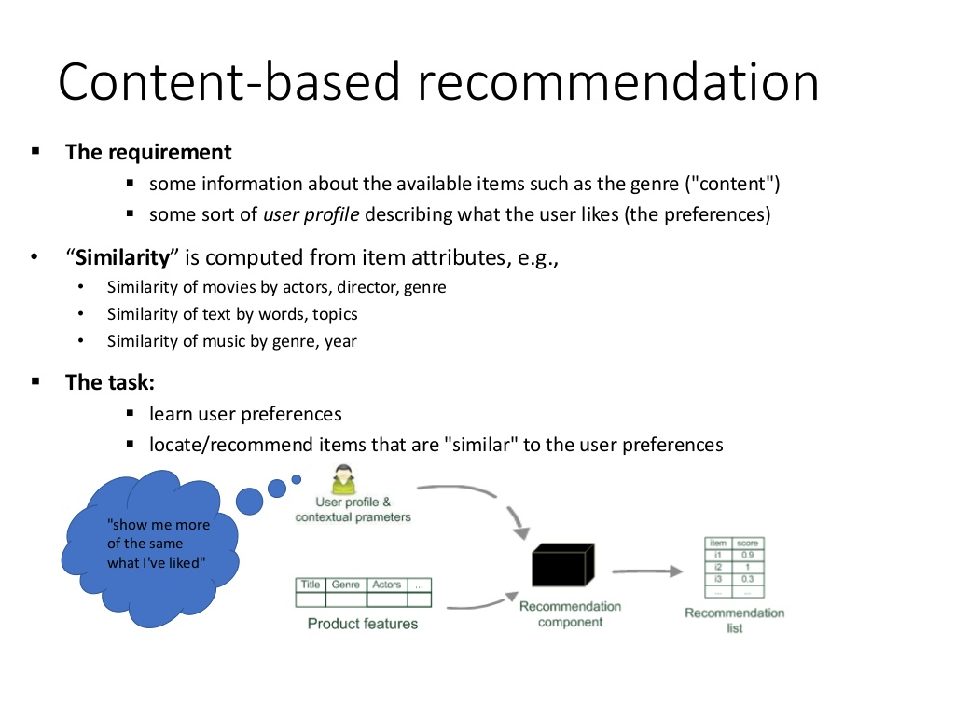
Content Based Recommendations

Slide 7
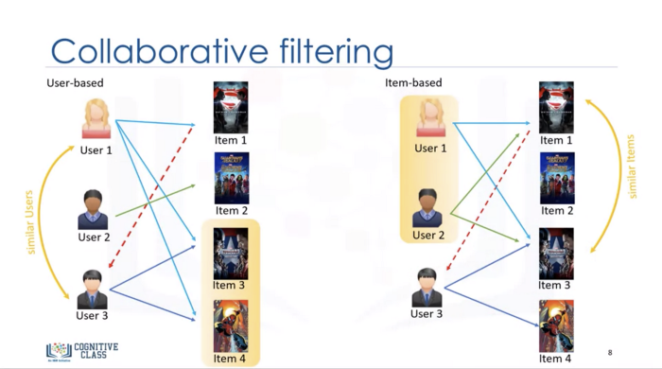

Slide 8
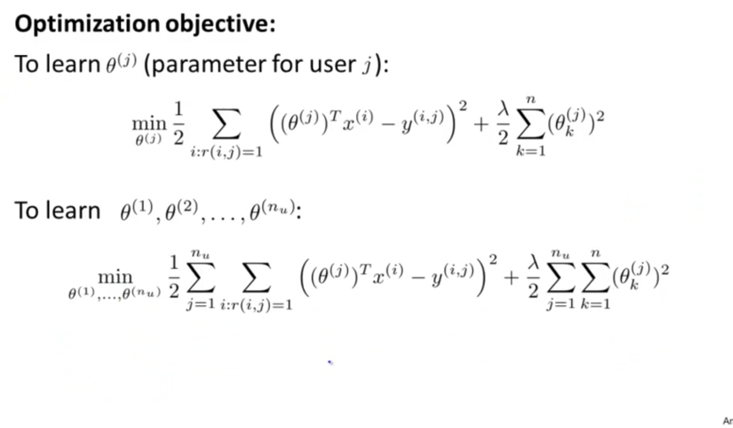
CONTENT BASED FORMULA

Slide 9
Using Music Album Information
Amy liked songs of Bahubali ConsiderRecommendations
Hero of the Movie is Prabhas → * Mirchi Movie Songs
Classified in the genre of romantic → *Romantic Songs
Music Director is MM Keeravani → * MM Keeravani Songs
This Technique is called Content Based Filtering

Slide 10
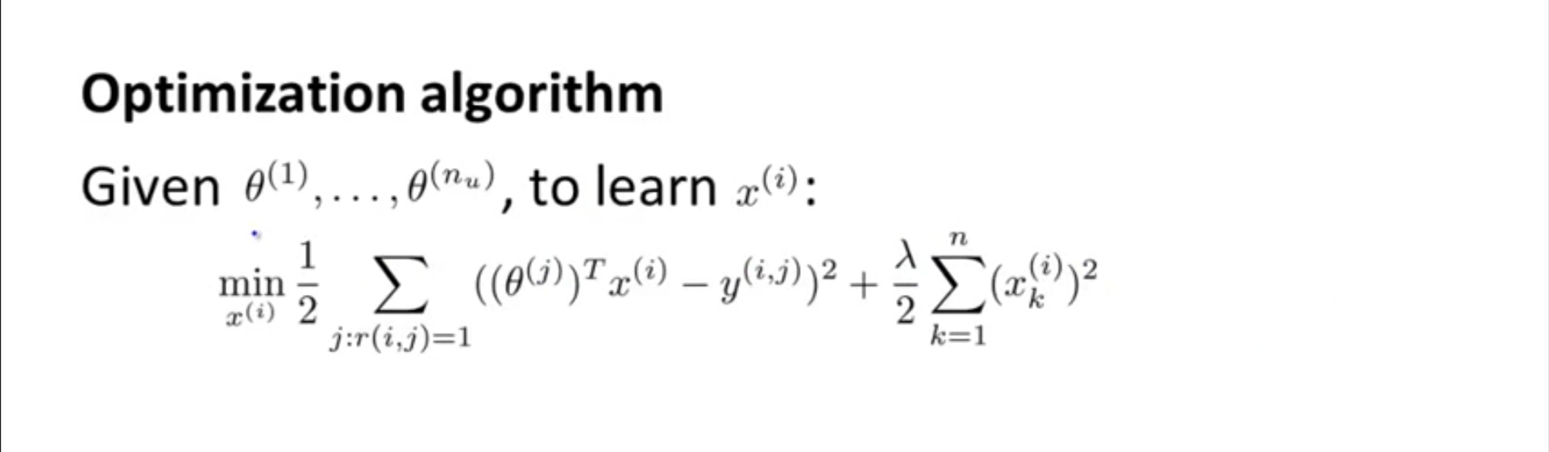
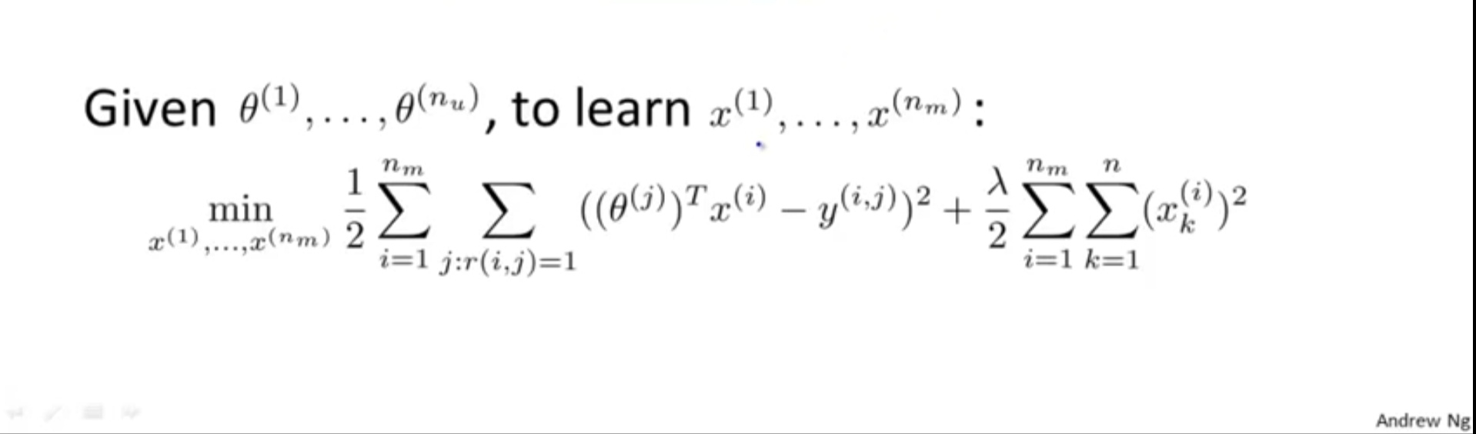
COLLABORATIVE FILTERING FORMULA

Slide 11


Slide 12
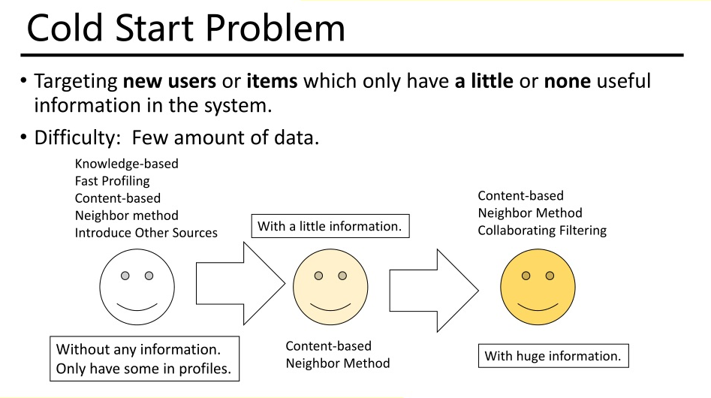

Slide 13
For cold start problem, Recommender systems make use of two different types of feedback (input). The most convenient is the high quality explicit feedback, that consists of an explicit preference given by a user for a given item. Often explicit feedback is collected via a star rating system. However, this kind of (precious) feedback is not always available (only few user give explicit feedback for items they have purchased) so recommender systems have to infer user preferences from the far more abundant implicit feedback.
SOLUTION TO COLD START PROBLEM : IMPLICIT AND EXPLICIT FEEDBACK

Slide 14
In an implicit model, once the user has given consent to collecting usage data, no additional explicit feedback action (e.g. ratings) is required on the user's side.
Implicit feedback includes purchase history, browsing history, search patterns, etc. For example, a user that purchased many books by the same author probably likes that author.

Slide 15
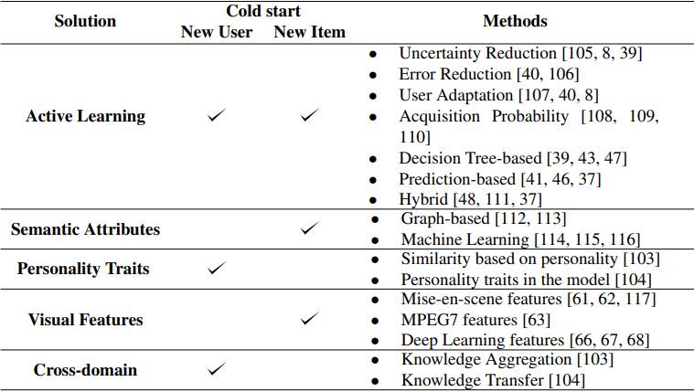

Slide 16
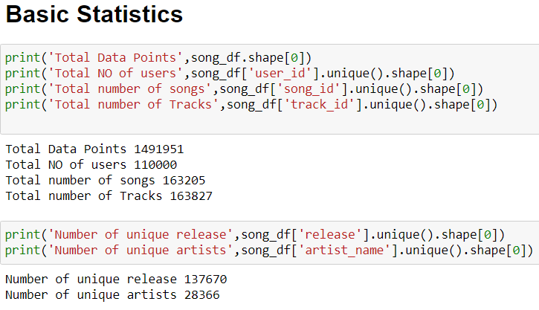
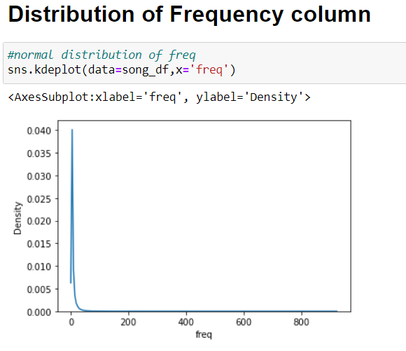
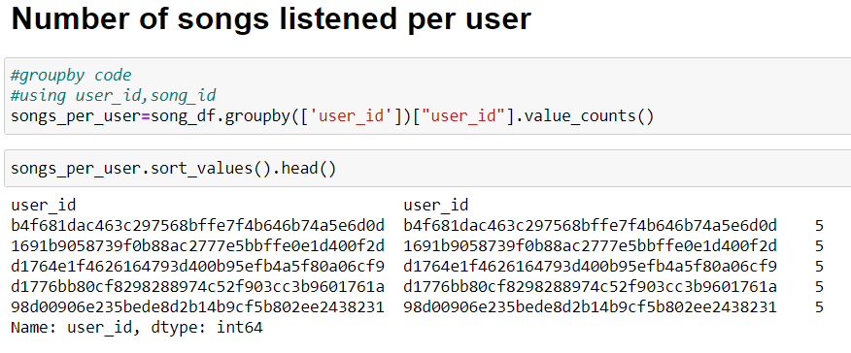
Explorative Data Analysis on the Dataset

Slide 17
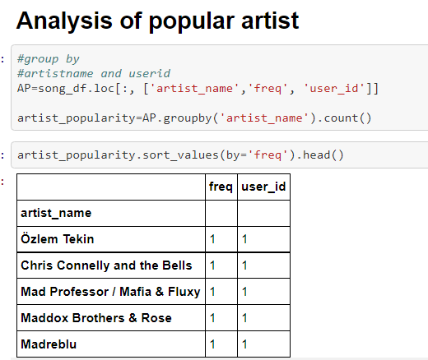
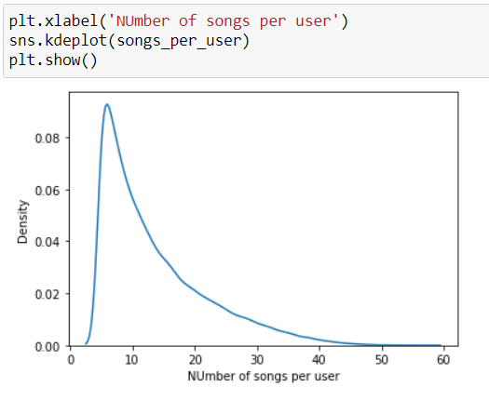
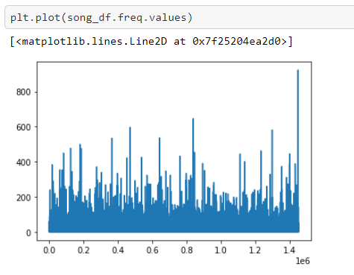
EDA (contind)

Slide 18
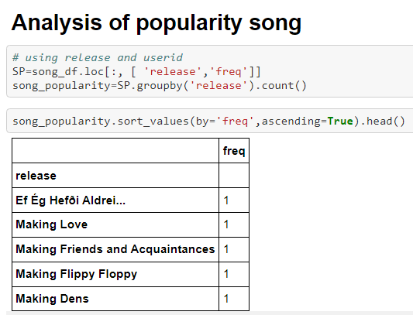
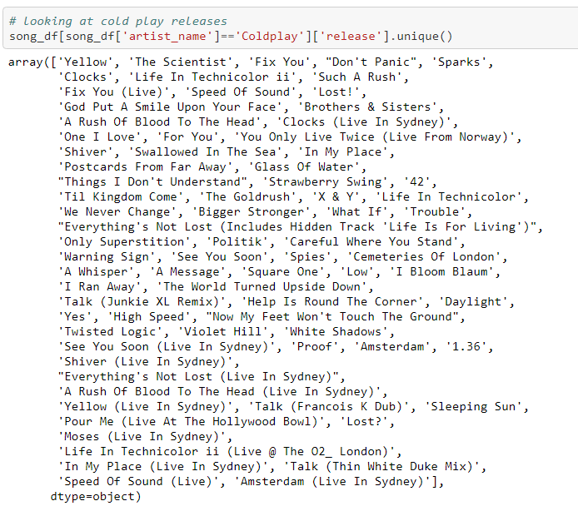
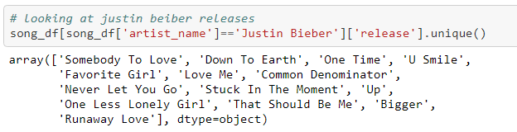

Slide 19
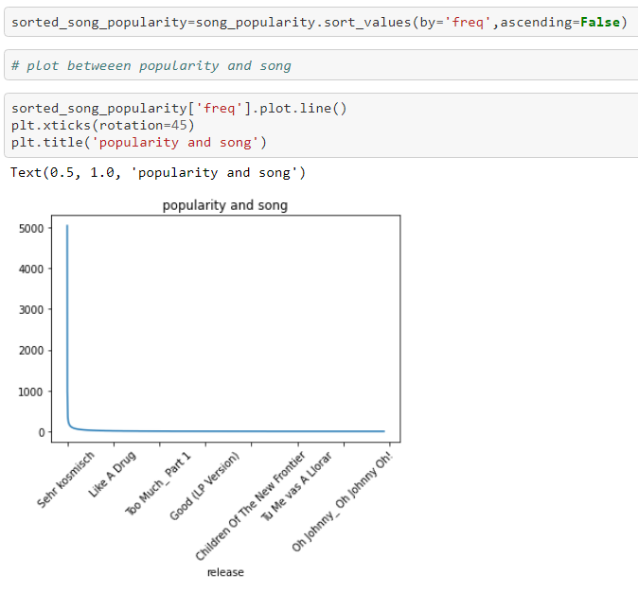
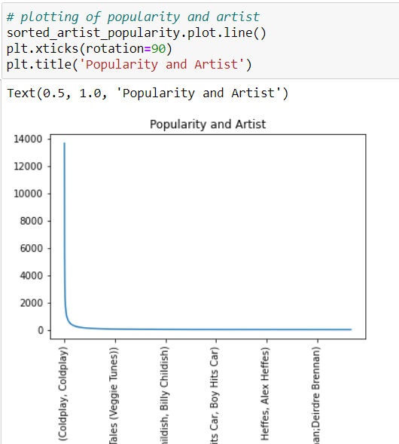

Slide 20
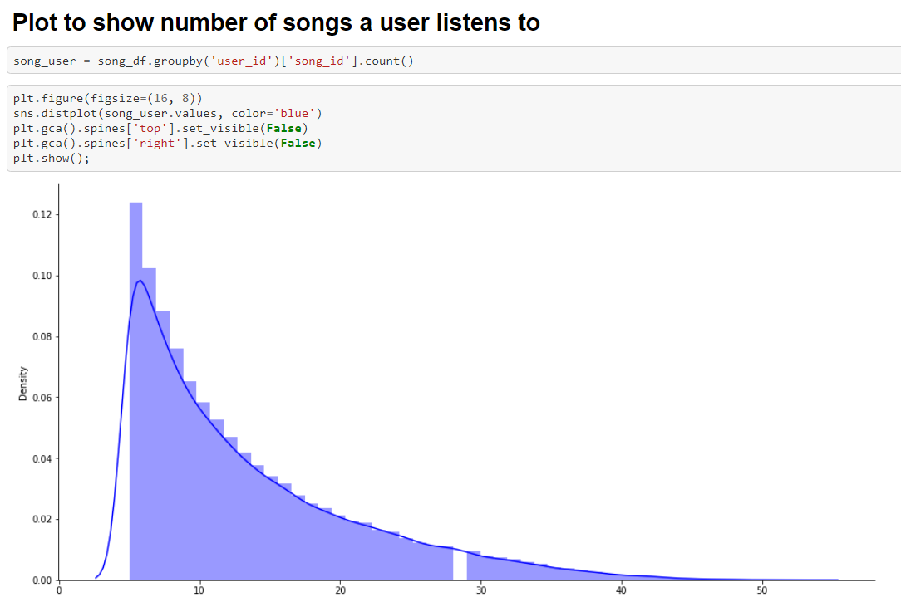
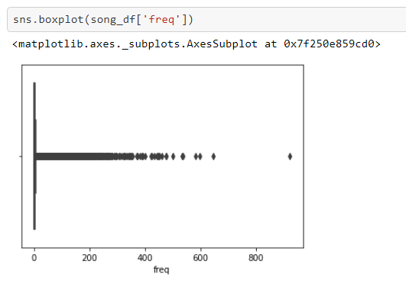
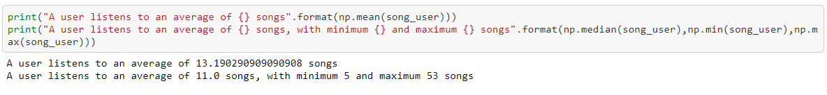
EDA (CONTND..)

Slide 21
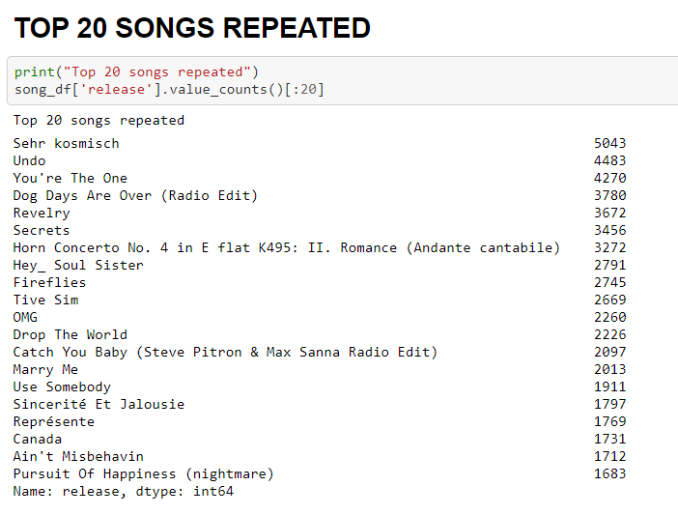
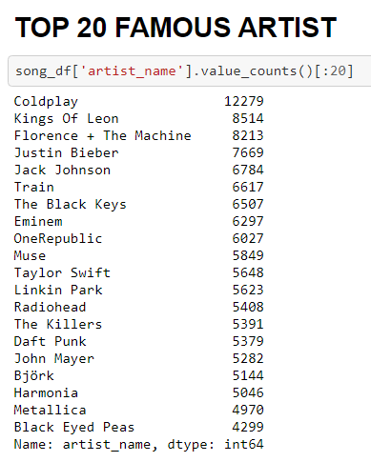
EDA (CONTD..)

Slide 22
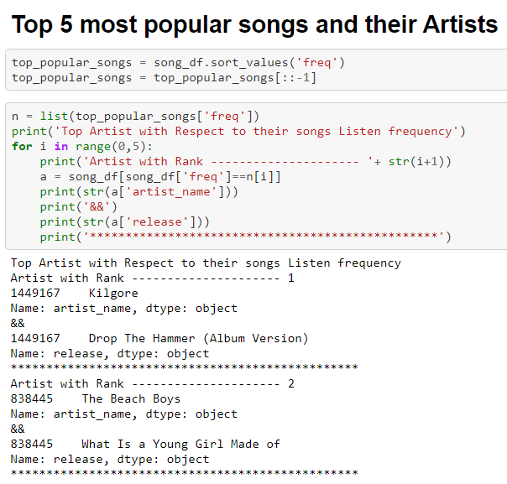

Slide 23
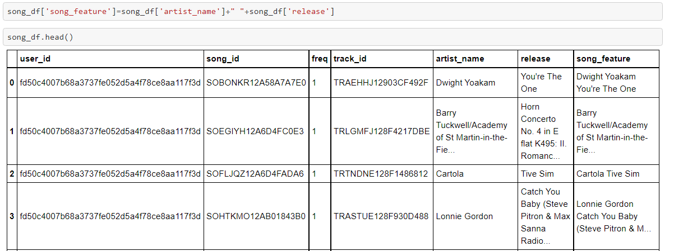
Data Preprocessing

Slide 24
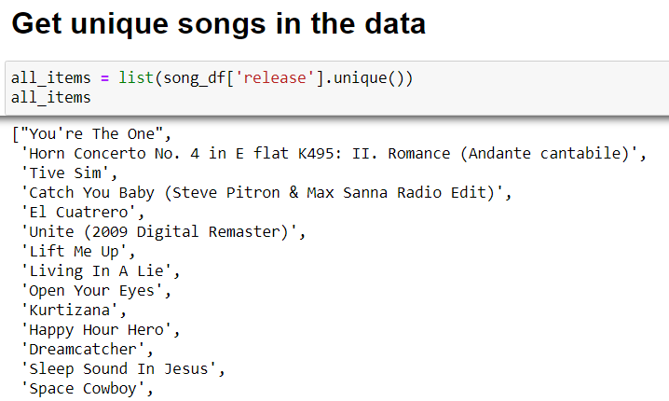
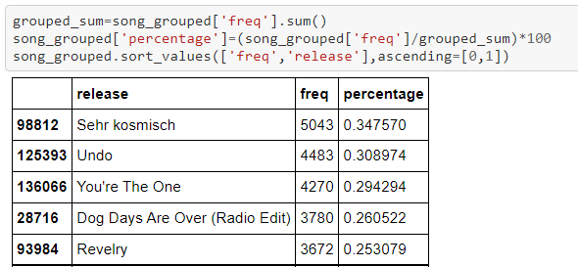
Data Preprocessing (contnd..)
Percentage of Frequency

Slide 25
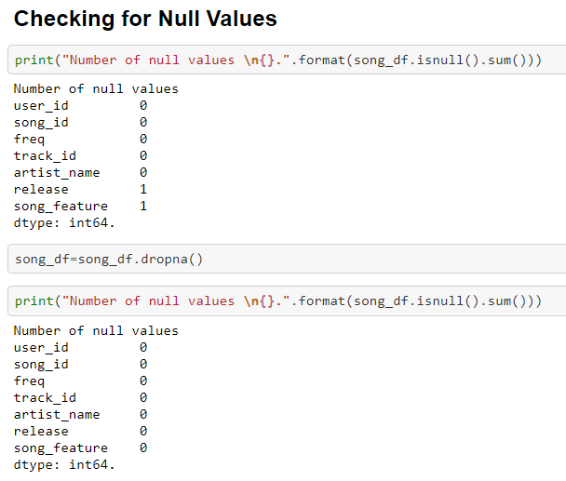

Slide 26
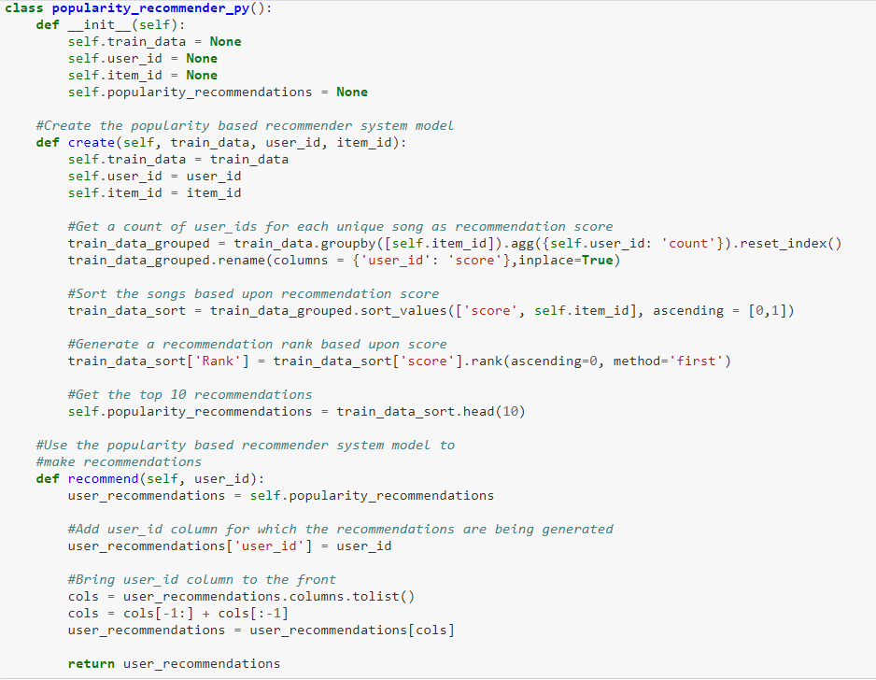
Popularity Based Recommender System

Slide 27
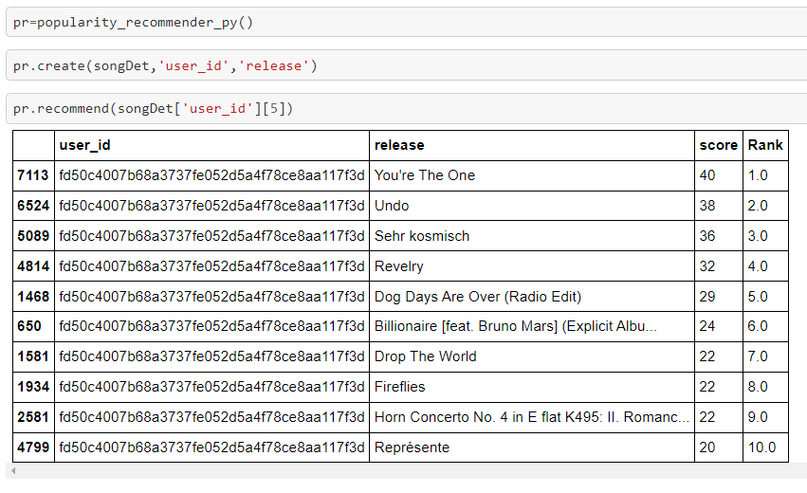
Popularity Based Recommendation (contnd..)
Hey Innominion, These are the most popular songs in trending right now, listen to it and follow the trend….☺ ☺☺
Innominion: I don’t follow the trend , I set the Trend ☺

Slide 28
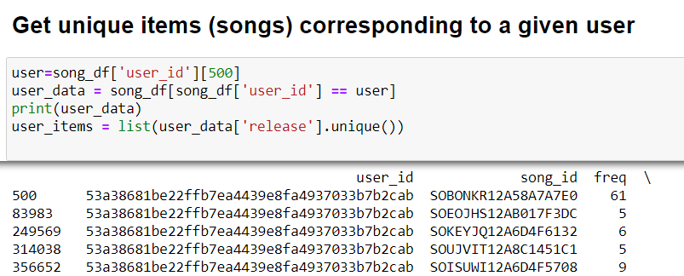
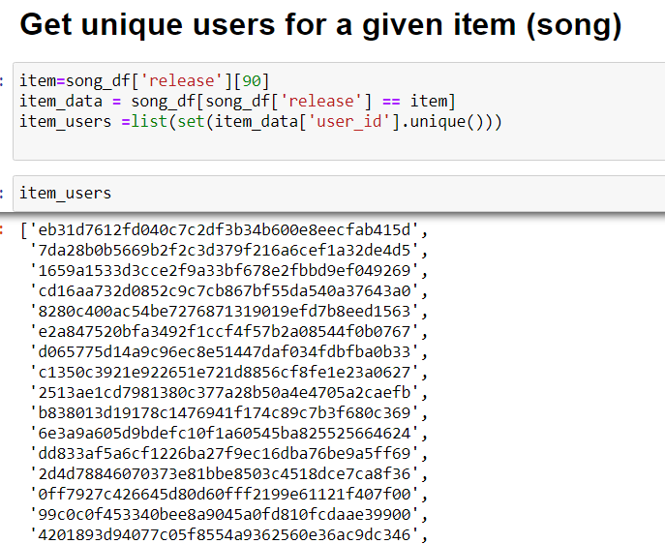
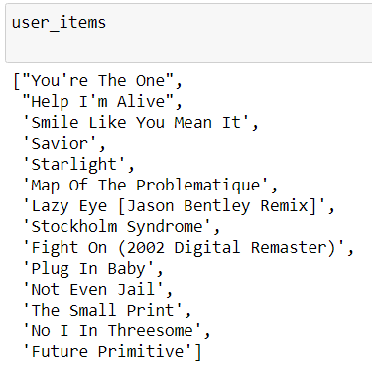
Item – Item Similarity Recommendation ( Collaborative Filtering)

Slide 29
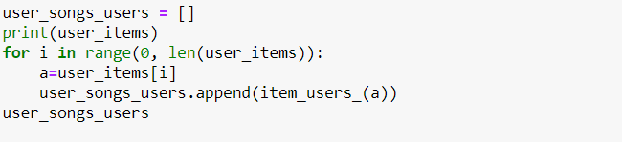
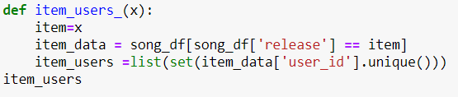
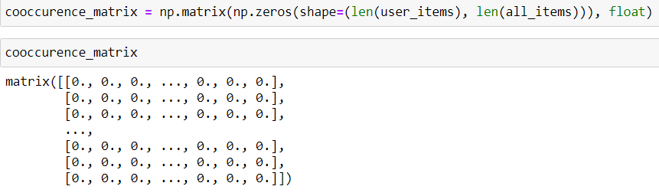
Item – Item Similarity Contnd..

Slide 30
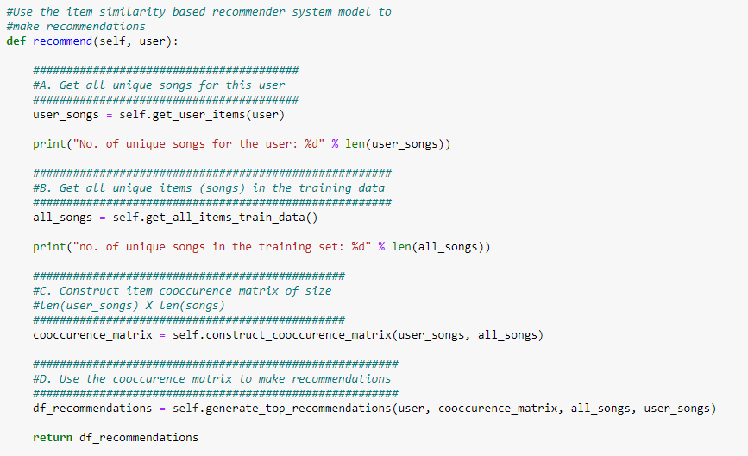
Item – Item Similarity Contnd..

Slide 31
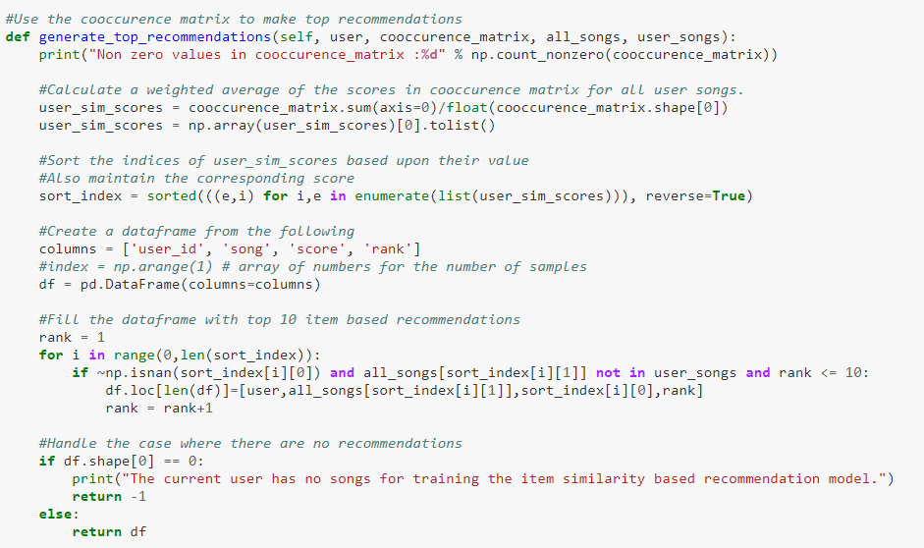
Item – Item Similarity Contnd..

Slide 32
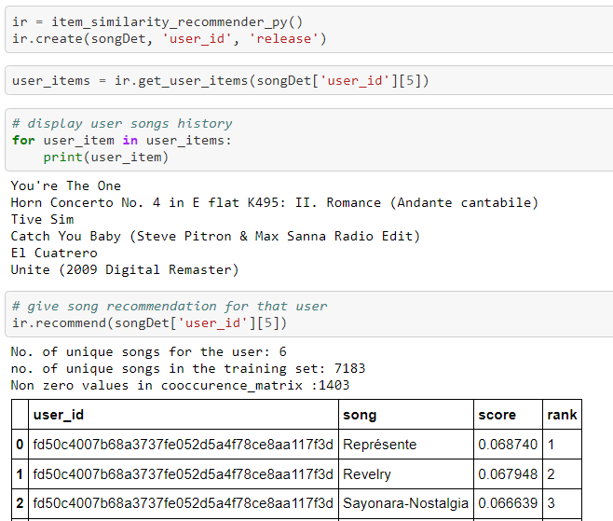
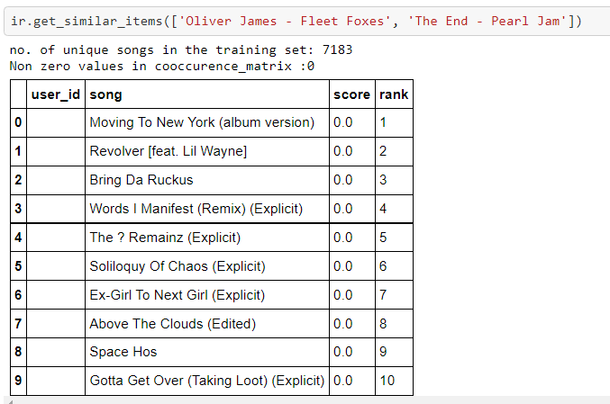

Slide 33
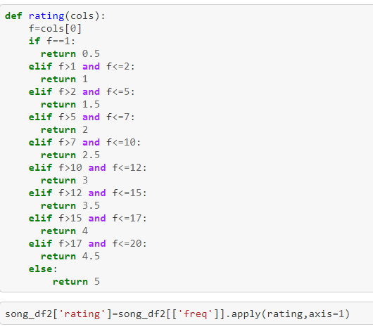
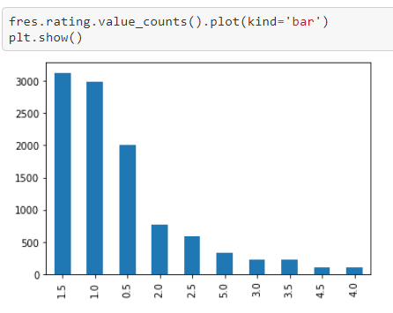
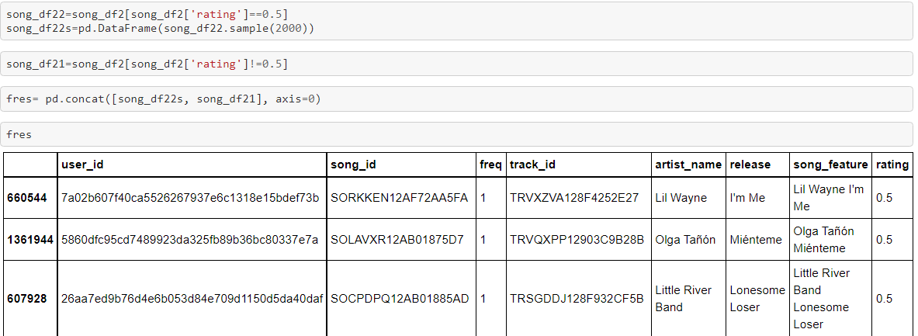
User Based Collaborative Filtering

Slide 34
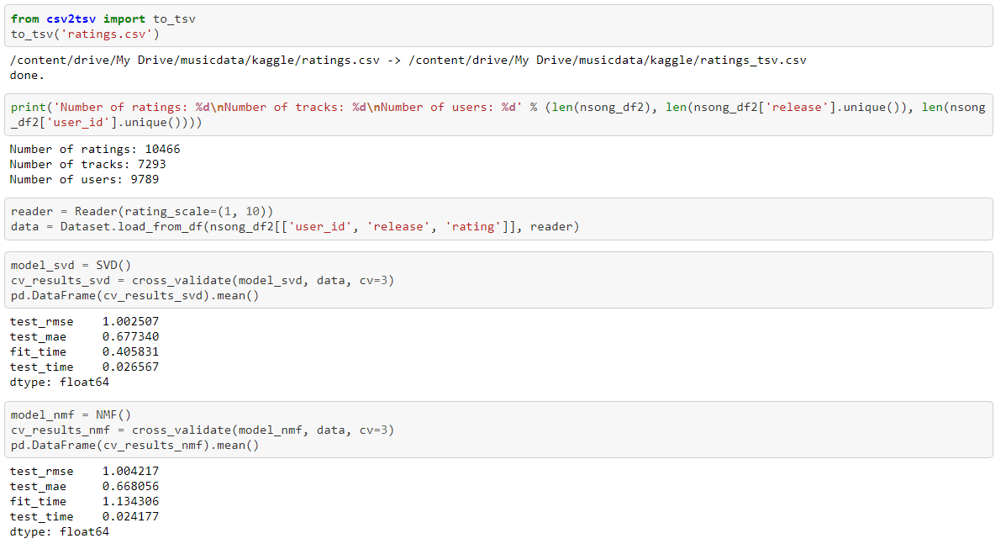

Slide 35
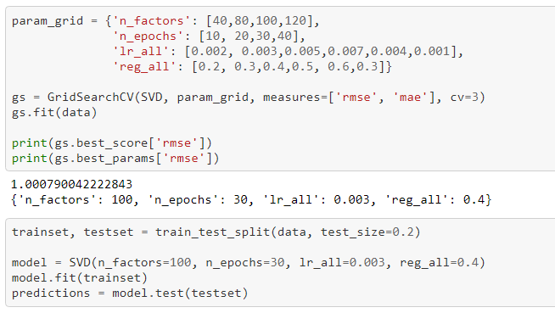
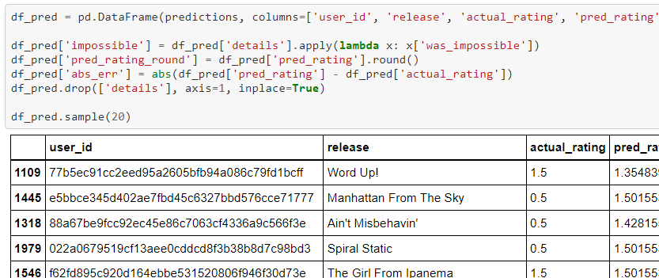
User Based Contnd..

Slide 36
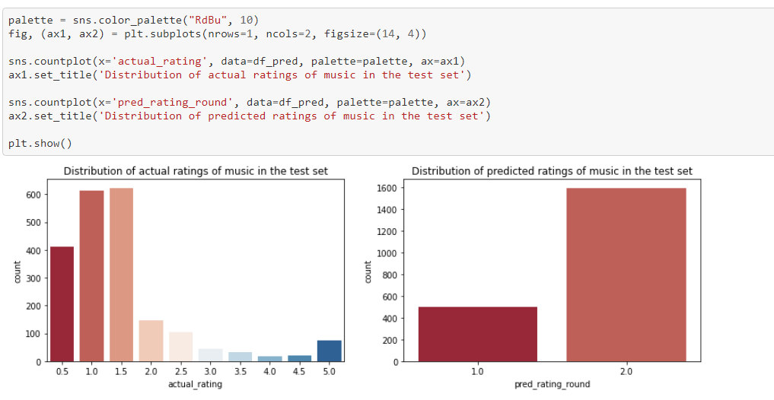
User Based contnd…

Slide 37
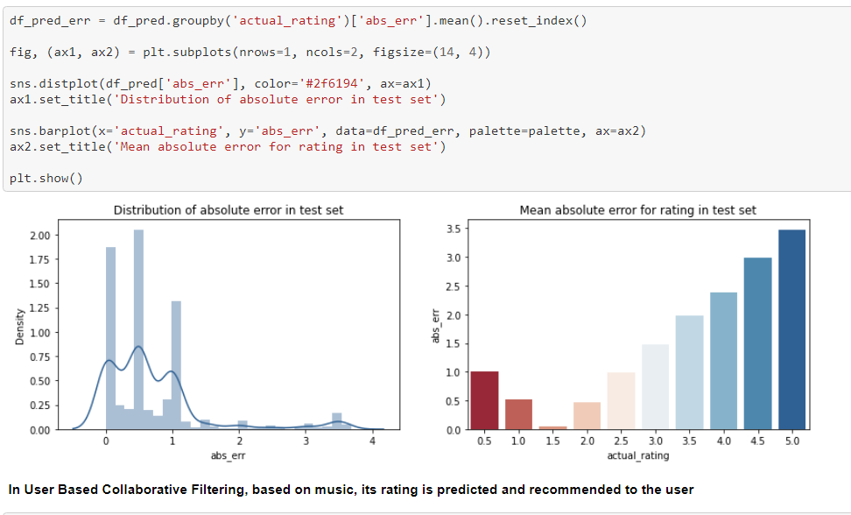
User Based contnd…

Slide 38
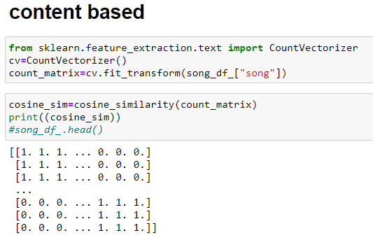
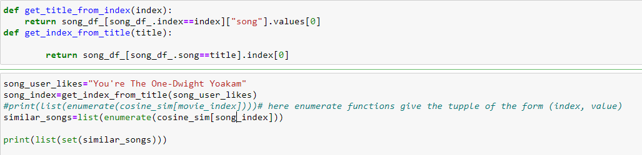
Content Based Filtering

Slide 39


Contend Based Filtering (contnd..)

Slide 40

THANK YOU

